Slide 1

MOVIE DIGITAL STREAMING SYSTEM API
Team 3
ALFIAN [FRONT END - NAVBAR, MOVIE, DELETE MOVIE] DEVANSH [FRONT END - LISTMOVIE, ADDMOVIE, SEARCH, ROUTING]
EU JINN, VERINE, NAZRIQ
[BACK END ]
INDEX.HTML

Slide 2
//SUMMARY
YOUR LOGO HERE
Digital Streaming Service is a service that allows the admin to put up movies and their details for the users.
Users can:
Add Movies
Search for Movies
Delete Movies
Edit Movies
INDEX.HTML

Slide 3
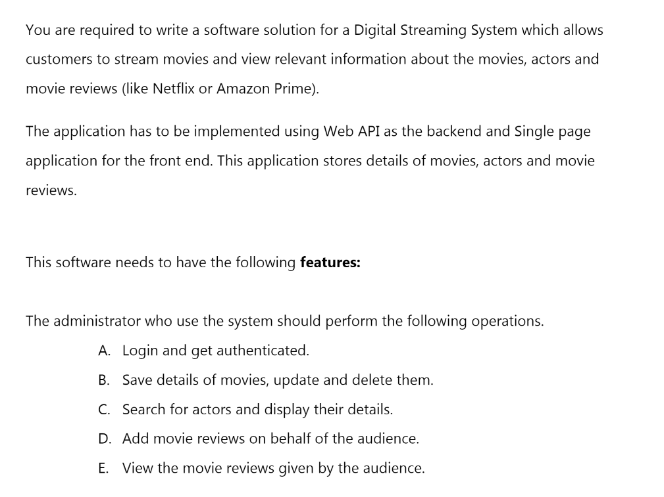

Slide 4
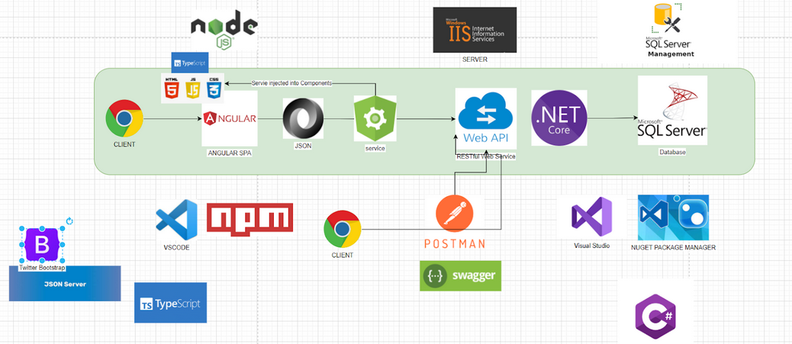
/PROJECT ARCHITECTURE OVERVIEW
YOUR LOGO HERE
INDEX.HTML

Slide 5
/TOPIC COVERED
/01
APPLICATION DEVELOPMENT LIFE CYCLE
/02
SQL
/03
ASP.NET CORE
/04
HTML/CSS/JS/ANGULAR
YOUR LOGO HERE
Understanding best practices and methodologies for developing applications
Database Queries
Building in-line web applications to CRUD APIs
Minor HTML registration forms with CSS, JS
INDEX.HTML

Slide 6
/01
/ADLC
YOUR LOGO HERE
Application Development Life Cycle
INDEX.HTML

Slide 7
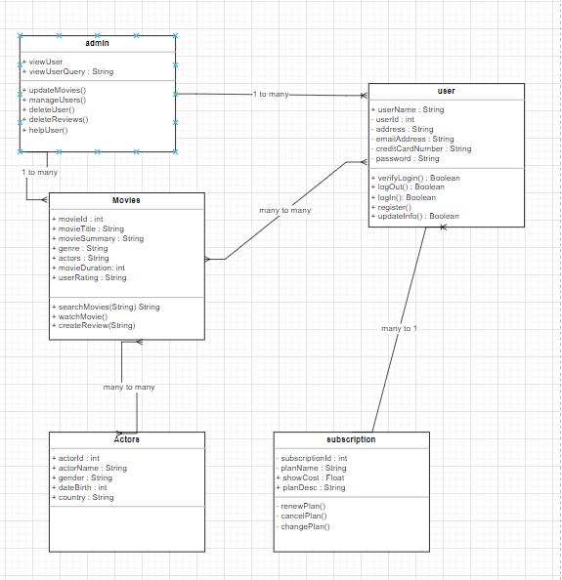
Class Diagram
Understanding objects and their relationship between each model.

Slide 8
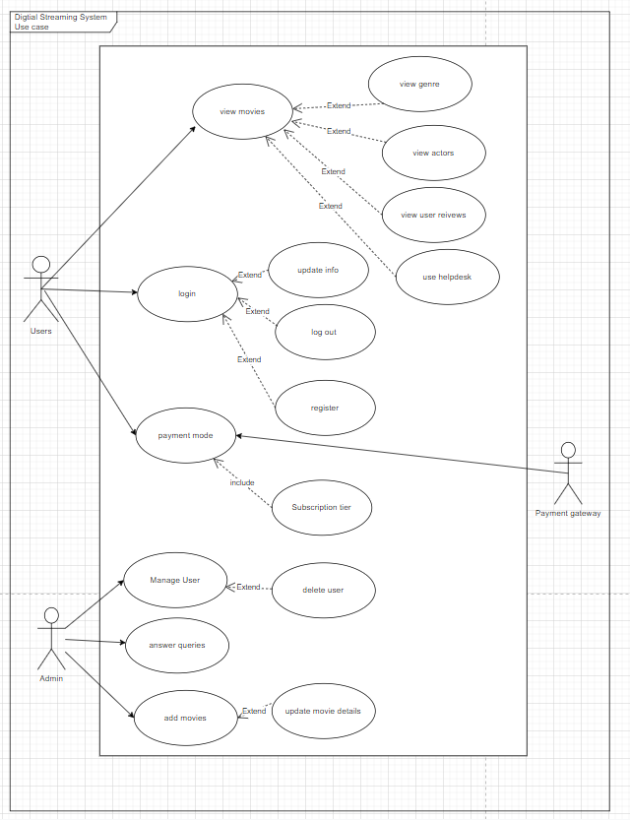
Use Case Diagram
Breaking down each function into actors and uses cases, understanding how they interact between systems and functions.

Slide 9
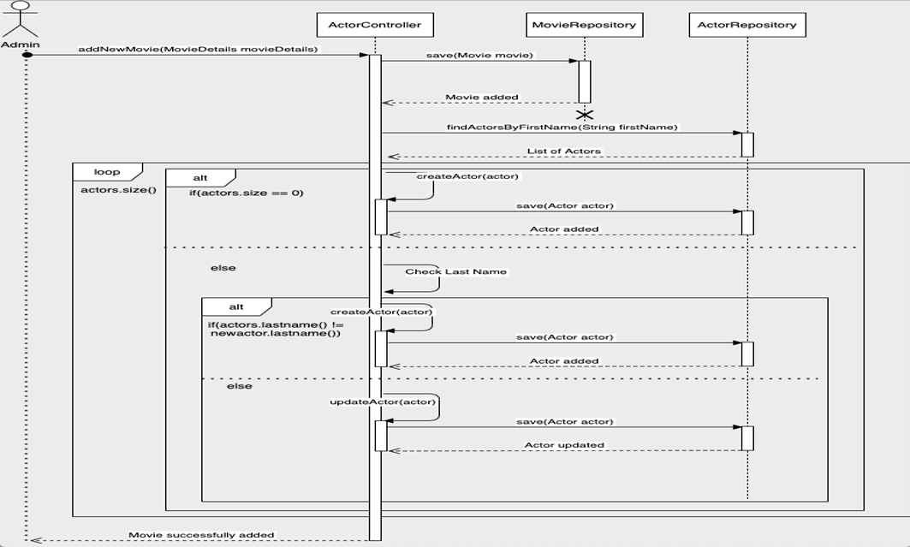
\SEQUENCE DIAGRAM

Slide 10
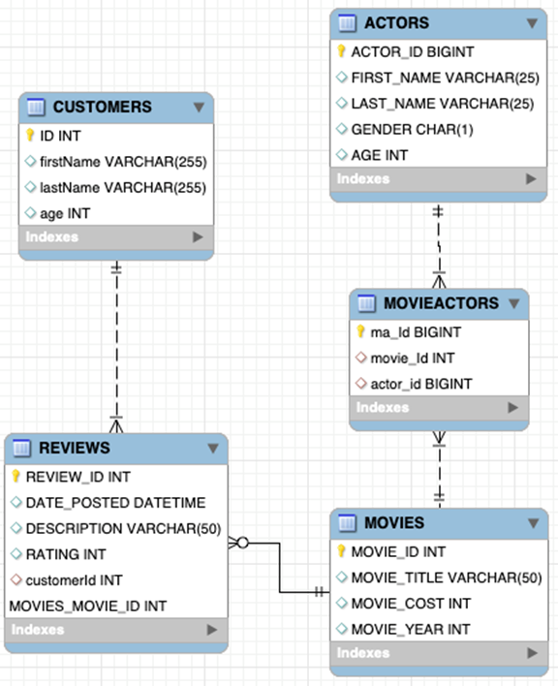
ENTITY RELATIONSHIP
DIAGRAM

Slide 11
/02
/SQL
YOUR LOGO HERE
Database Query
INDEX.HTML

Slide 12



/DATABASE
/FRONTEND
/BACKEND
YOUR LOGO HERE
INDEX.HTML

Slide 13




\FRAMEWORKS

Slide 14
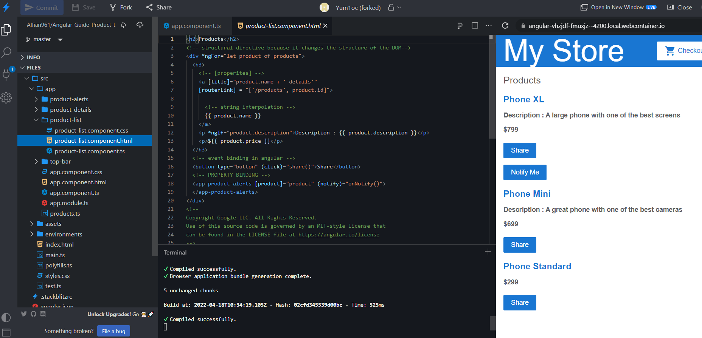
2 DAY ANGULAR SPRINT

Slide 15
FRONT-END PROJECT

Slide 16
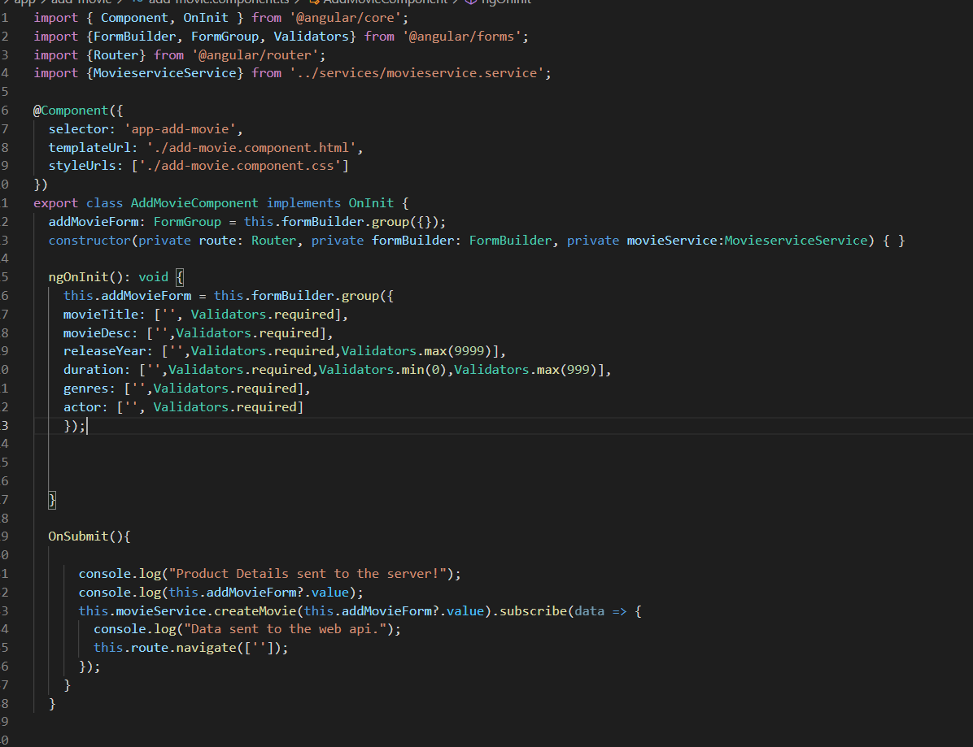

Slide 17
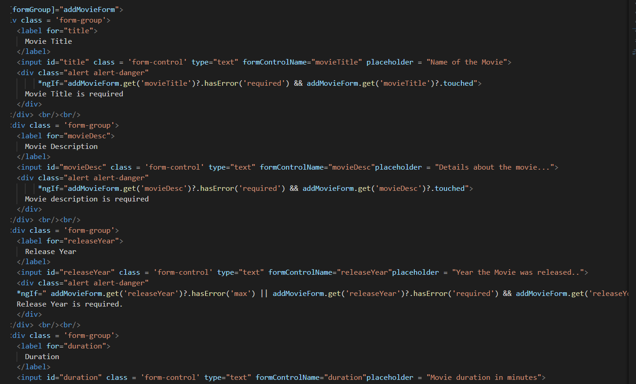

Slide 18
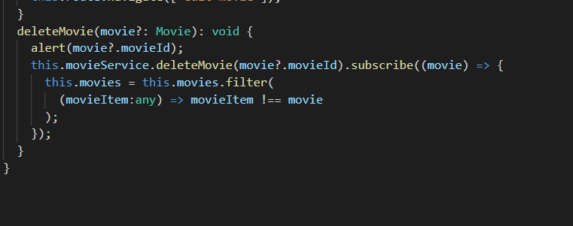
DELETE FUNCTION

Slide 19
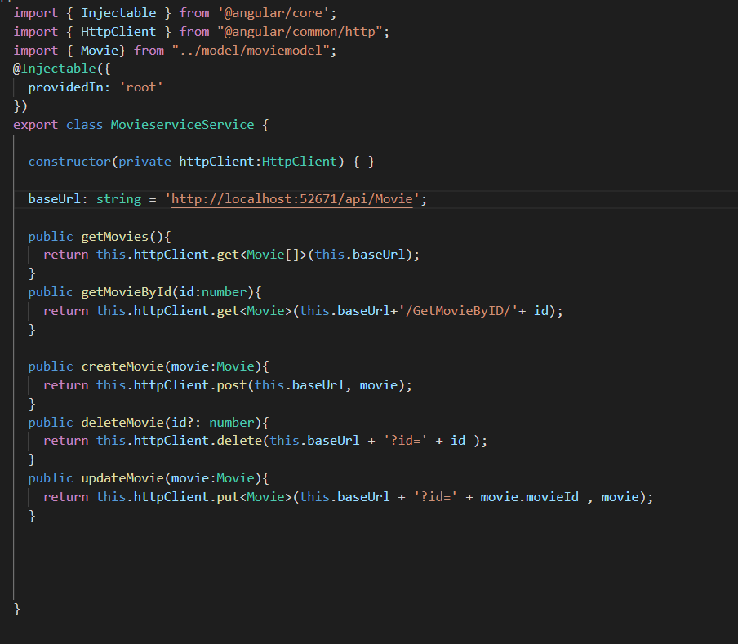
SERVICES

Slide 20
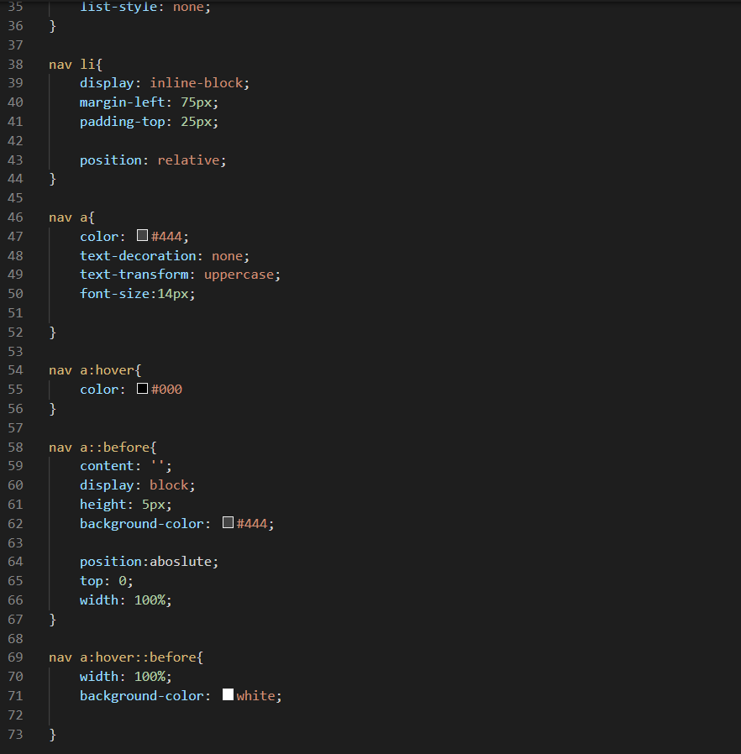
NAVBAR CSS

Slide 21
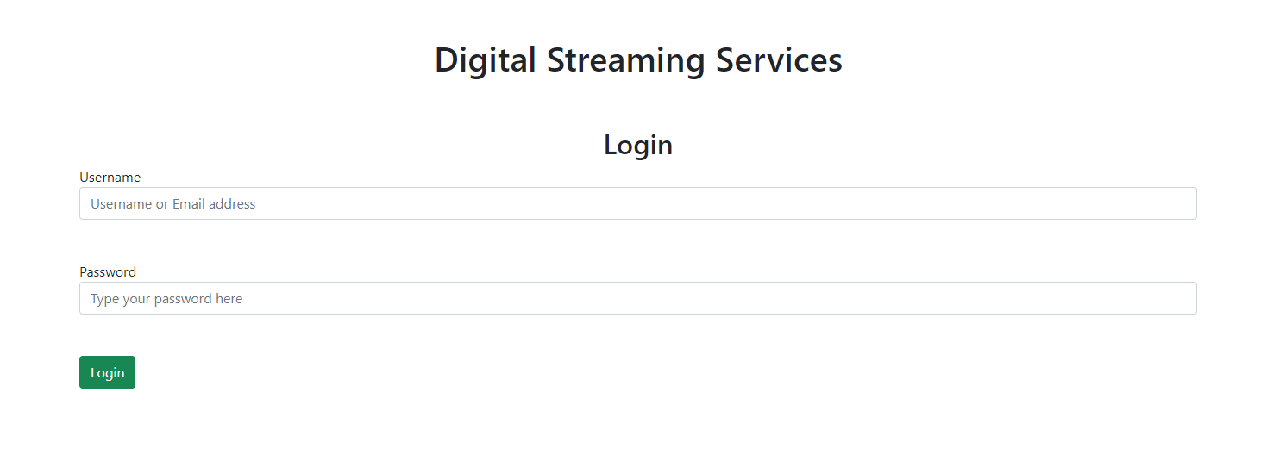
Login

Slide 22
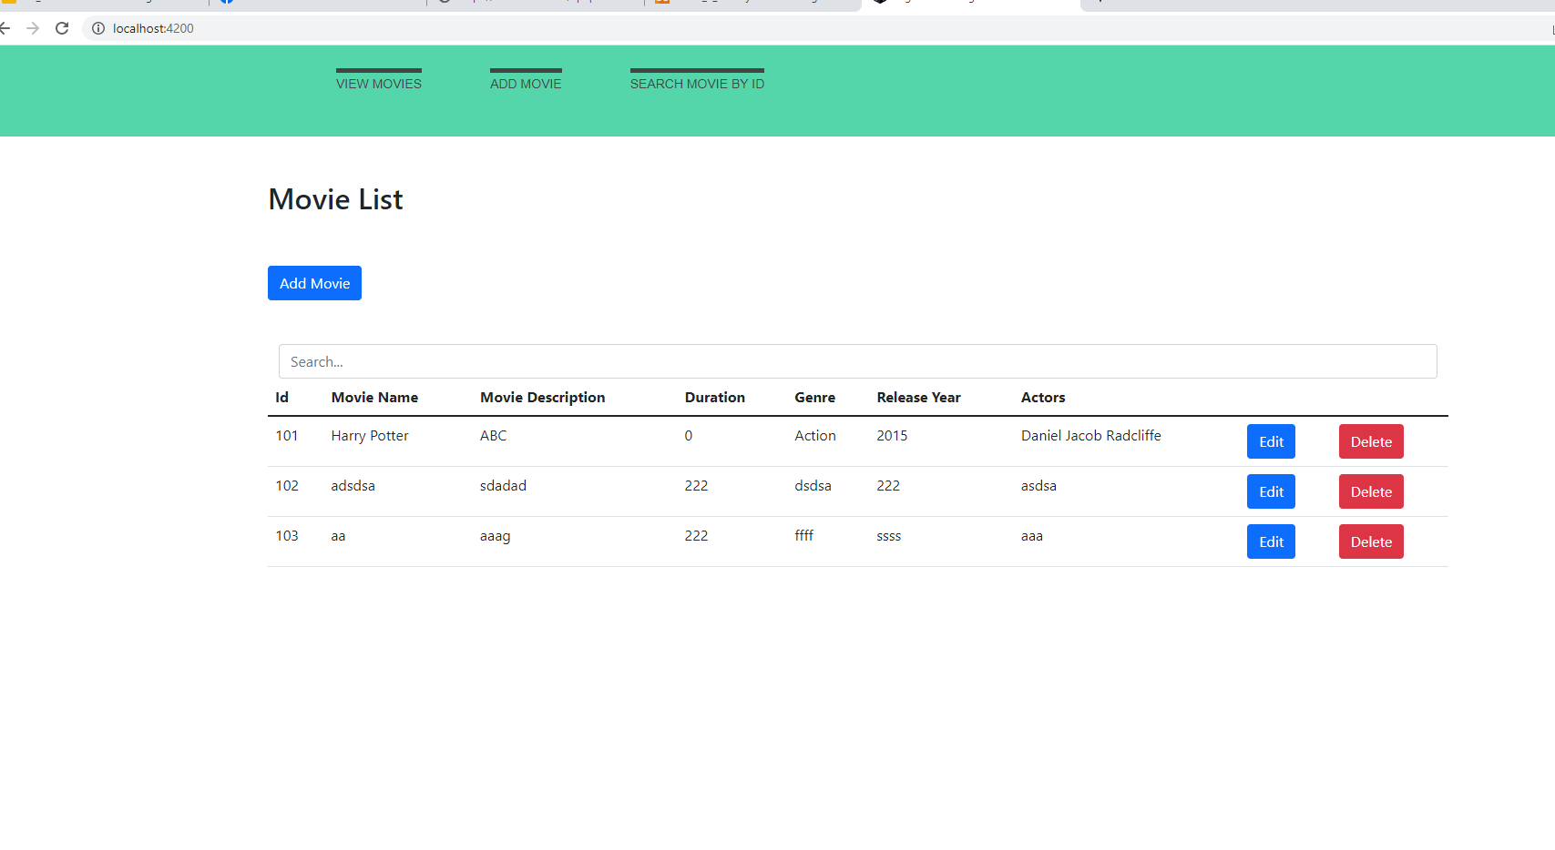
RUNNING APP SCREENSHOTS

Slide 23
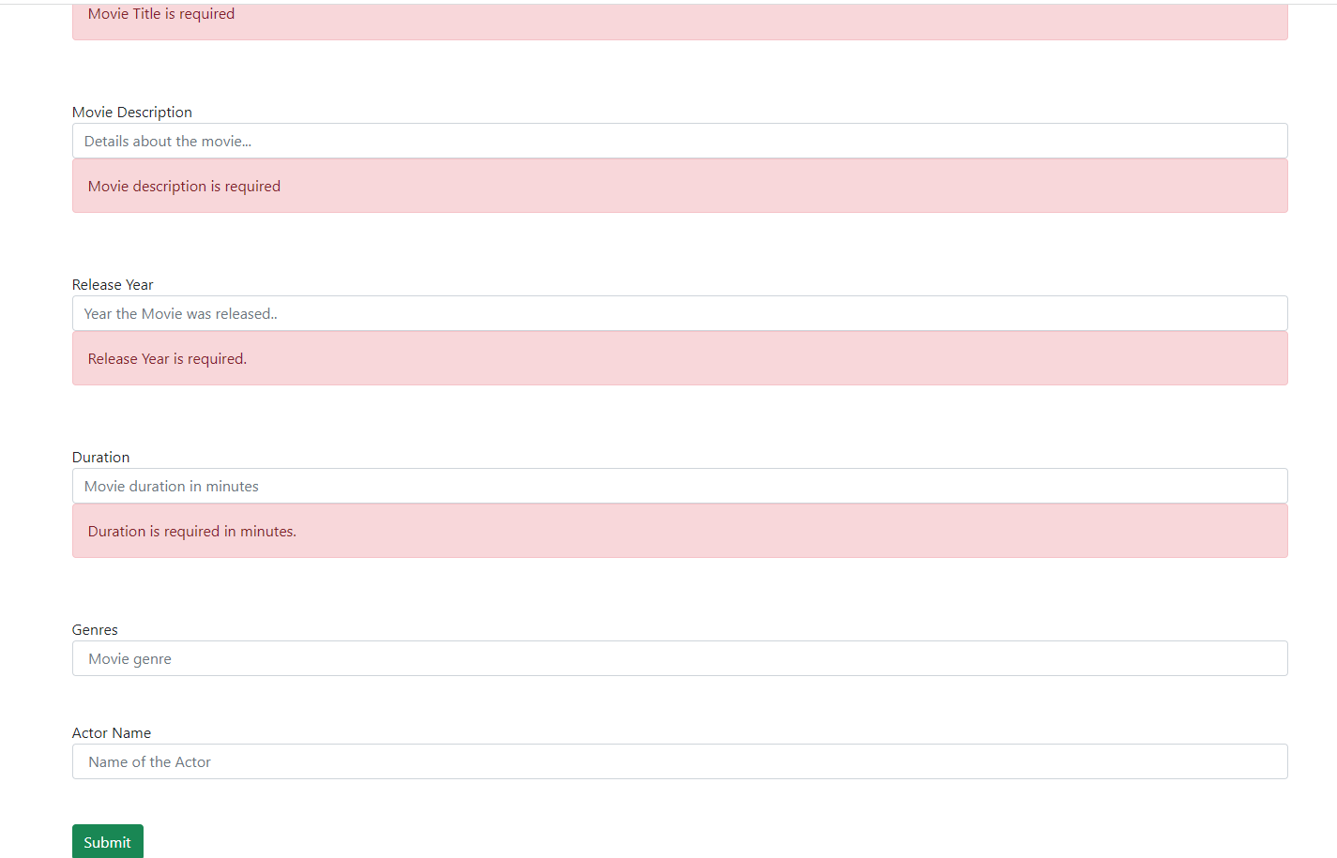
RUNNING APP SCREENSHOTS

Slide 24
RUNNING APP SCREENSHOTS

Slide 25
.NET PROJECT

Slide 26
/TOPIC COVERED
/01
MODELS
/02
SERVICES
/03
REPOSITORIES
/04
CONTROLLERS
YOUR LOGO HERE
Creating objects and properties
Use representational data to transfer data from from our models
create an abstraction layer between Data Access Layer and business logic
Routing and returning data
INDEX.HTML

Slide 27
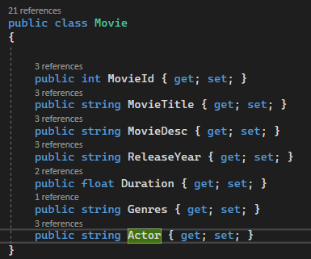
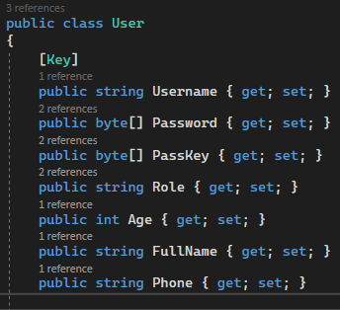
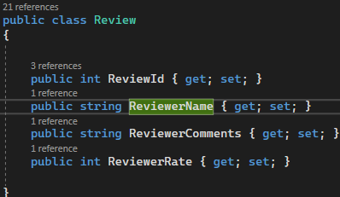
Models

Slide 28
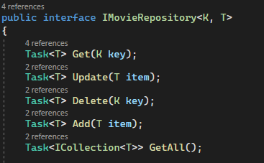
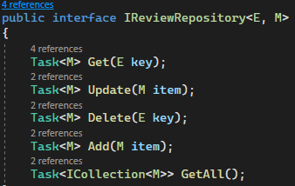
Repository

Slide 29
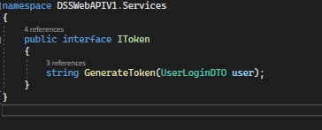
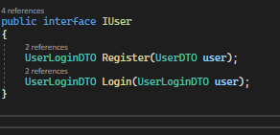
IUser & IToken

Slide 30
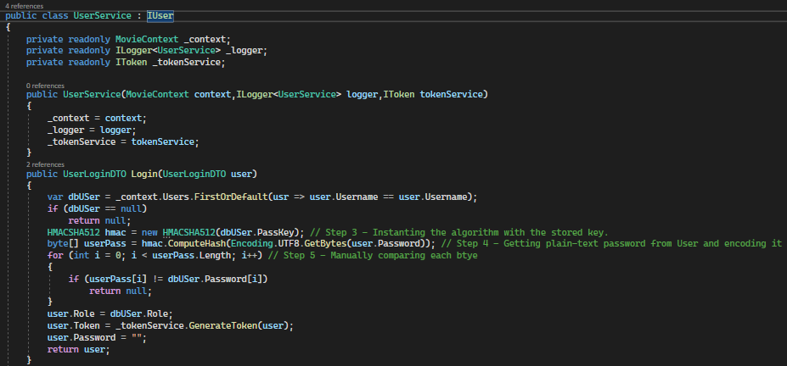
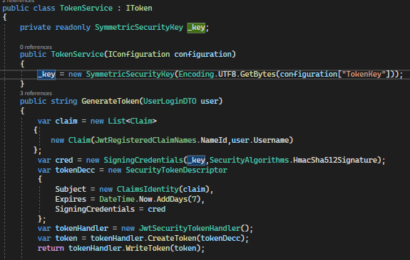
IUser & IToken

Slide 31
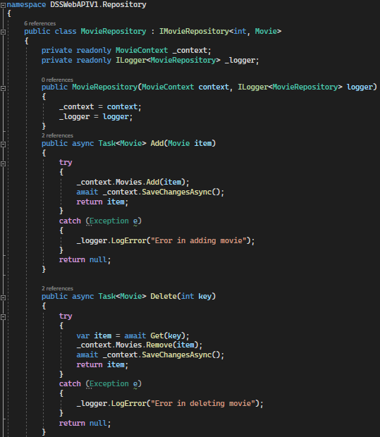
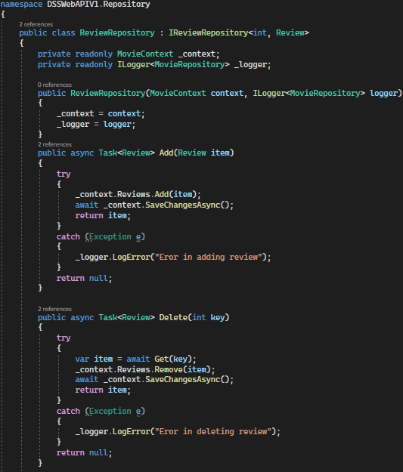
Repository implementation

Slide 32
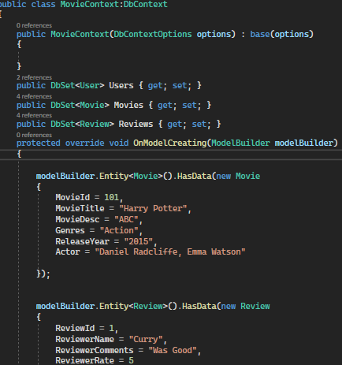
Movie Context

Slide 33
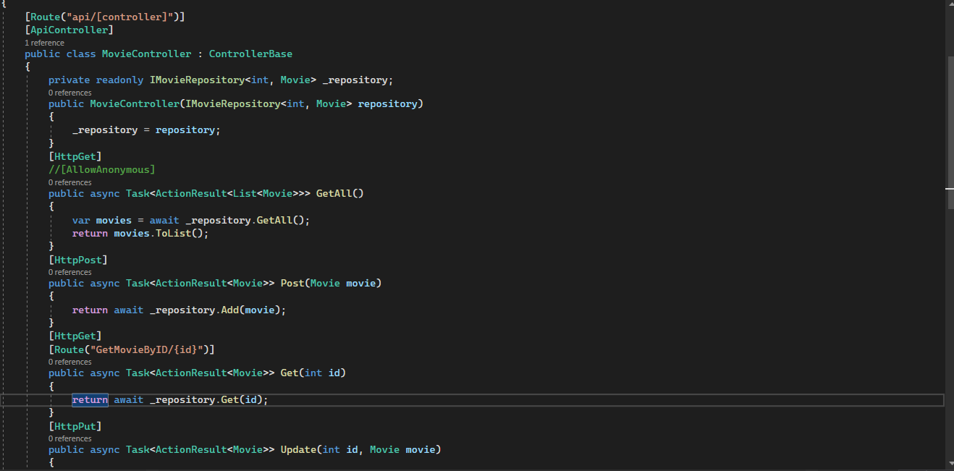
Movie : API Controller

Slide 34
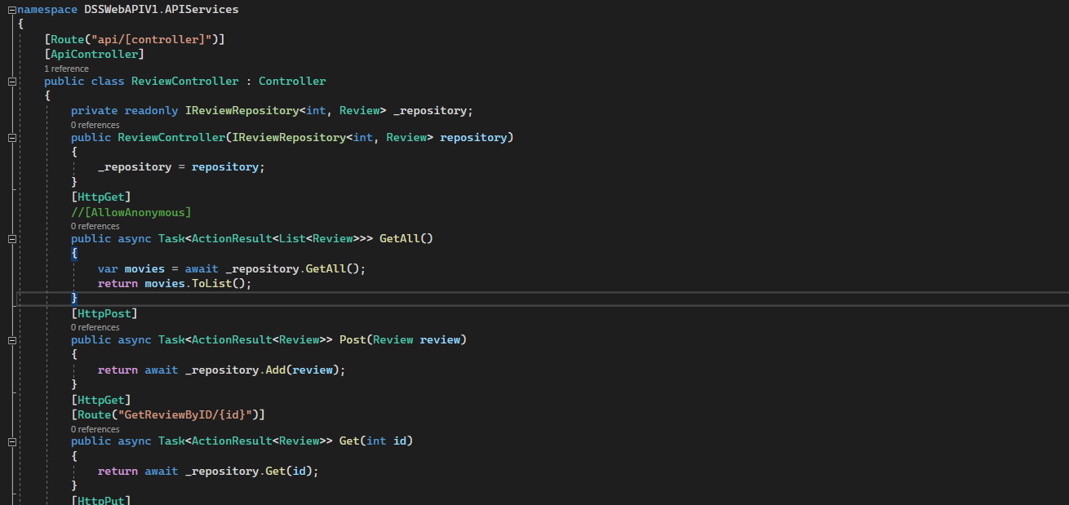
Review: API Controller

Slide 35
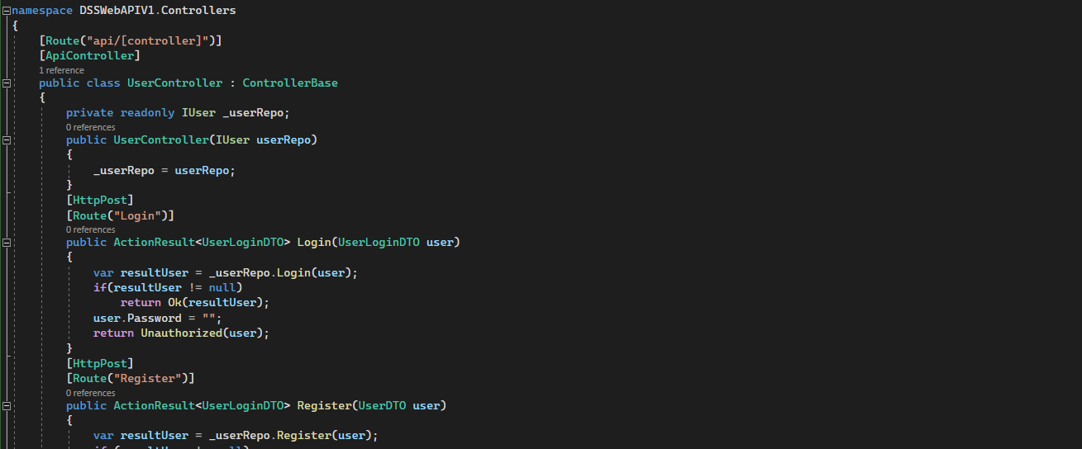
API Controller

Slide 36
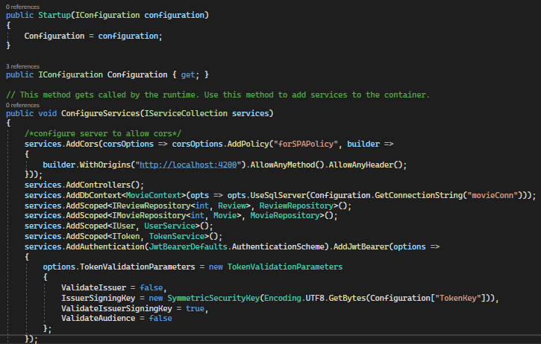
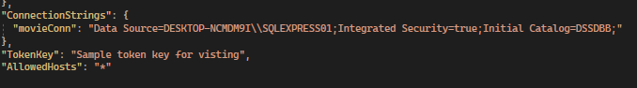
Appsettings.json & Startup.cs
Connection String

Slide 37
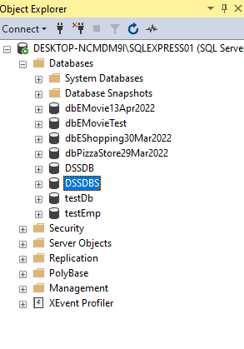
SQL

Slide 38
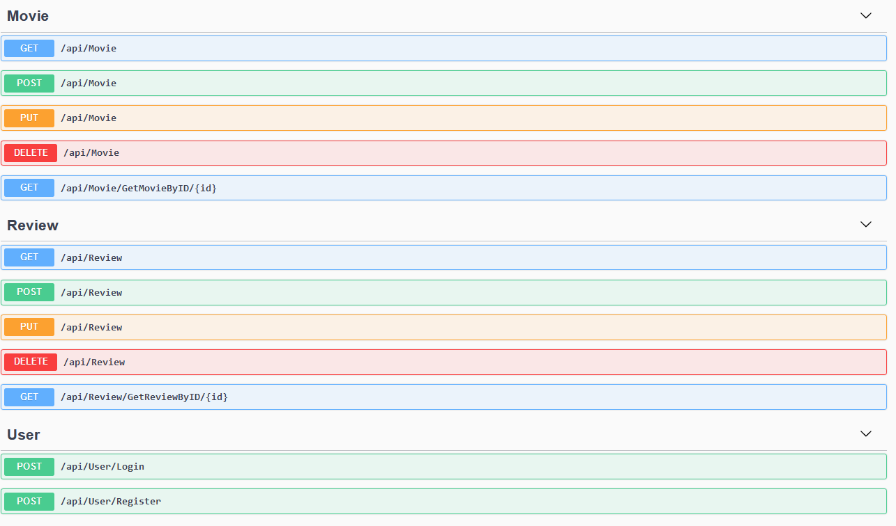
/Testing with SWAGGER

Slide 39
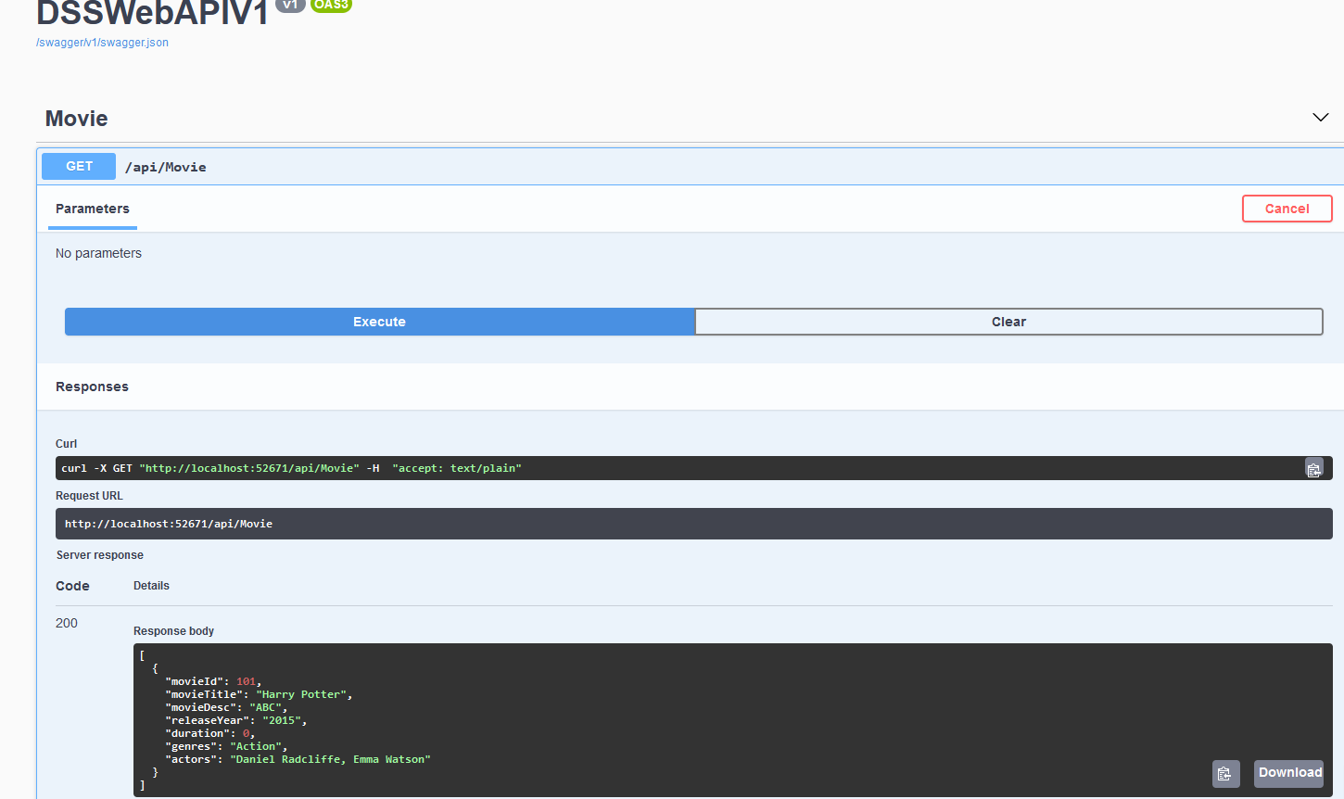
/Testing with SWAGGER
YOUR LOGO HERE
INDEX.HTML

Slide 40

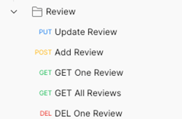
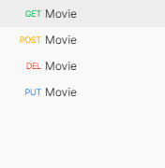
POSTMAN : API TESTING

Slide 41
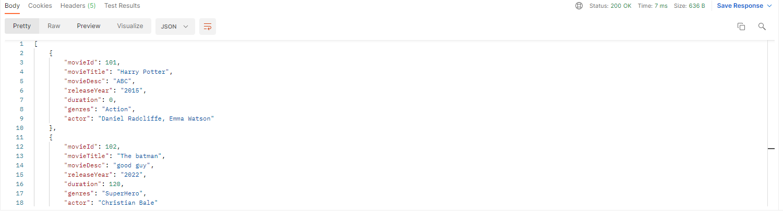
SIMPLE TEST CASES WITH POSTMAN

Slide 42
Learning Points
We learnt how to create real world APIs that are used in business contexts.
CRUD Operations and building RESTful API services.
Connecting with our frontEnd team to create a holistic product for our users (Movie Digital Streaming Service)
Cross-learning different platforms with Angular and creating pages.

Slide 43
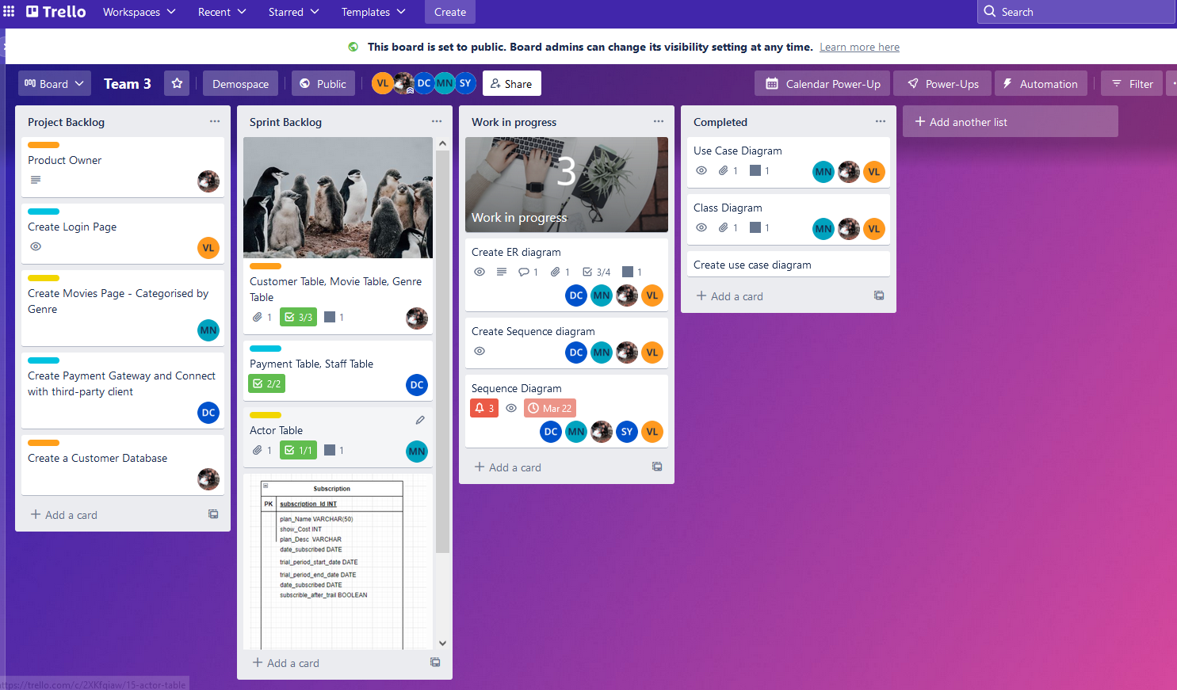
AGILE ACTIVATES
.

Slide 44
/THANKS!
YOUR LOGO HERE
INDEX.HTML

